Slide 1
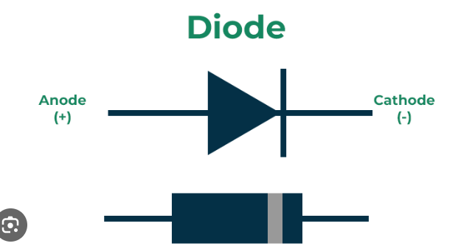
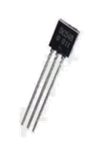
Classification of Power Semiconductor Switches
Based on number of terminals
1) Two-terminal devices
2) Three-terminal devices
Based on the degree of controllability
1) Uncontrollable switches (Diodes)
2) Semi-Controllable switches (Thyristors)
3) Fully-controllable switches (BJT, MOSFET, IGBT, GTO)
Collector
Collector
Base
Base
Emitter
P-n-p
Emitter
N-p-n

Slide 2
Ideal Controllable Switch
It should...
Block arbitrarily large forward and reverse voltages with zero current flow when OFF.
Conduct arbitrarily large currents with zero voltage drop when on.
Switch from on to off or vice versa instantaneously when triggered.
Vanishingly small power required from control source to trigger the switch.

Slide 3
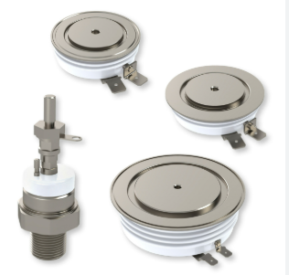
GTO (Gate Turn – Off thyristor)
V AK
i A
+
-
Cathode (K)
Anode(A)
i G
Gate(G)

Slide 4
GTO (Gate Turn – Off thyristor)
Operation Principle:
The turn ON operation of GTO is similar to a conventional thyristor. When the anode
terminal is made positive with respect to cathode by applying a positive gate current,
the hole current injection from gate forward bias the cathode p-base junction.
To turn OFF a conducting GTO, a reverse bias is applied at the gate by making the
gate negative with respect to cathode.

Slide 5
GTO (Gate Turn – Off thyristor)
GTO suffer from long switch off times.
Restricted maximum switching frequency to about 1 kHz.
Still GTO is approximately ten times faster than that of a comparable SCR.
Poor turn-off current gain and the second-breakdown problem at turn-off.
limited operating frequency of less than 5 kHz.
Complex Gate Drive Design.

Slide 6
GTO (Gate Turn – Off thyristor)
Applications:
AC drives
DC drives or DC choppers
AC stabilizing power supplies
DC circuit breakers
Induction heating

Slide 7
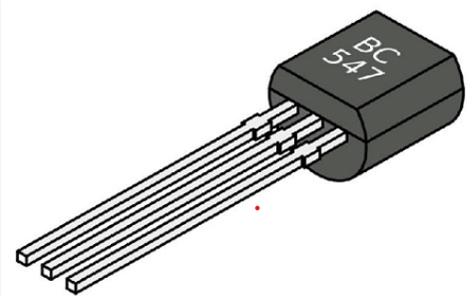
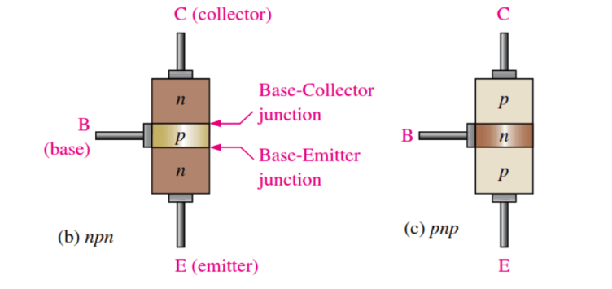
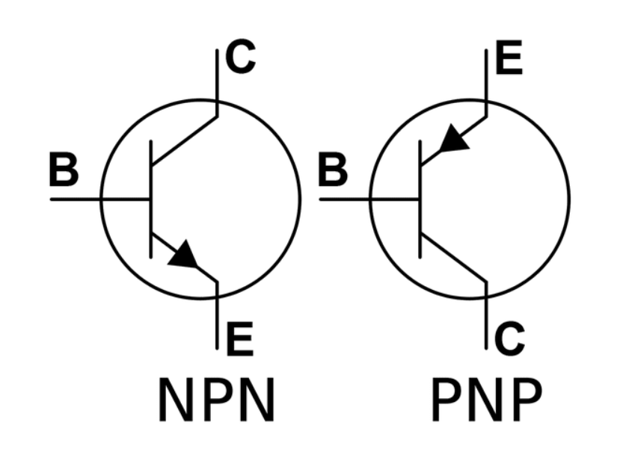
BJT (Bipolar Junction Transistor)

Slide 8
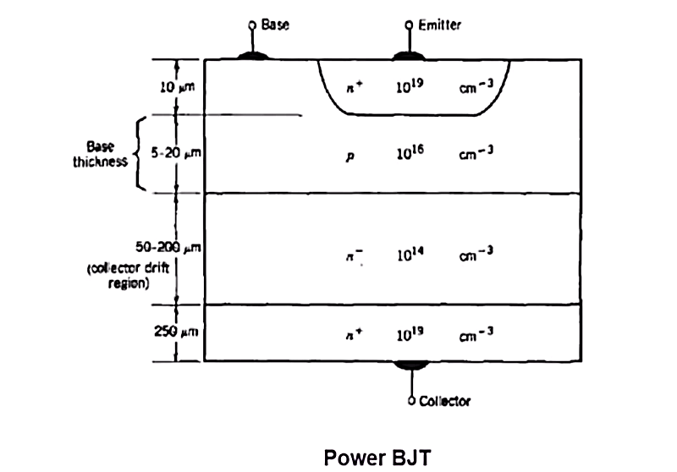
BJT (Bipolar Junction Transistor)

Slide 9
Thank you

